Slide 1


Predicting fake messages and tamper identification
With the steady growth of so many internets based cheap Social media, media channels and networks, people spread fake news.
Fake message is harmful, and can be extremely dangerous as there is no mechanism to verify.
This is an idea to predict whether a media can potentially be fake or not, globally.

Slide 2
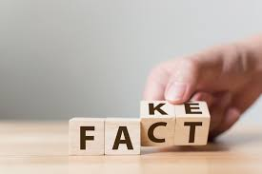


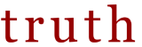
The Situation
What is happening and What is the Problem
In 2013 The World Economic Forum warned that fake news would be one of the biggest threats faced by society
Can harm business and state institutions , with enterprise or political level influence
Can lead to huge loss in terms of money and properties or both
Verify and monitor the validity.
Identify if it is tampered with
Once under radar, keep the full track round the clock.

Slide 3



Solution Steps – Check Creation
Find hash from image using hashing technology
Use invisible watermark technology to embed the hash into image using advanced image processing method
Register in Blockchain

Slide 4
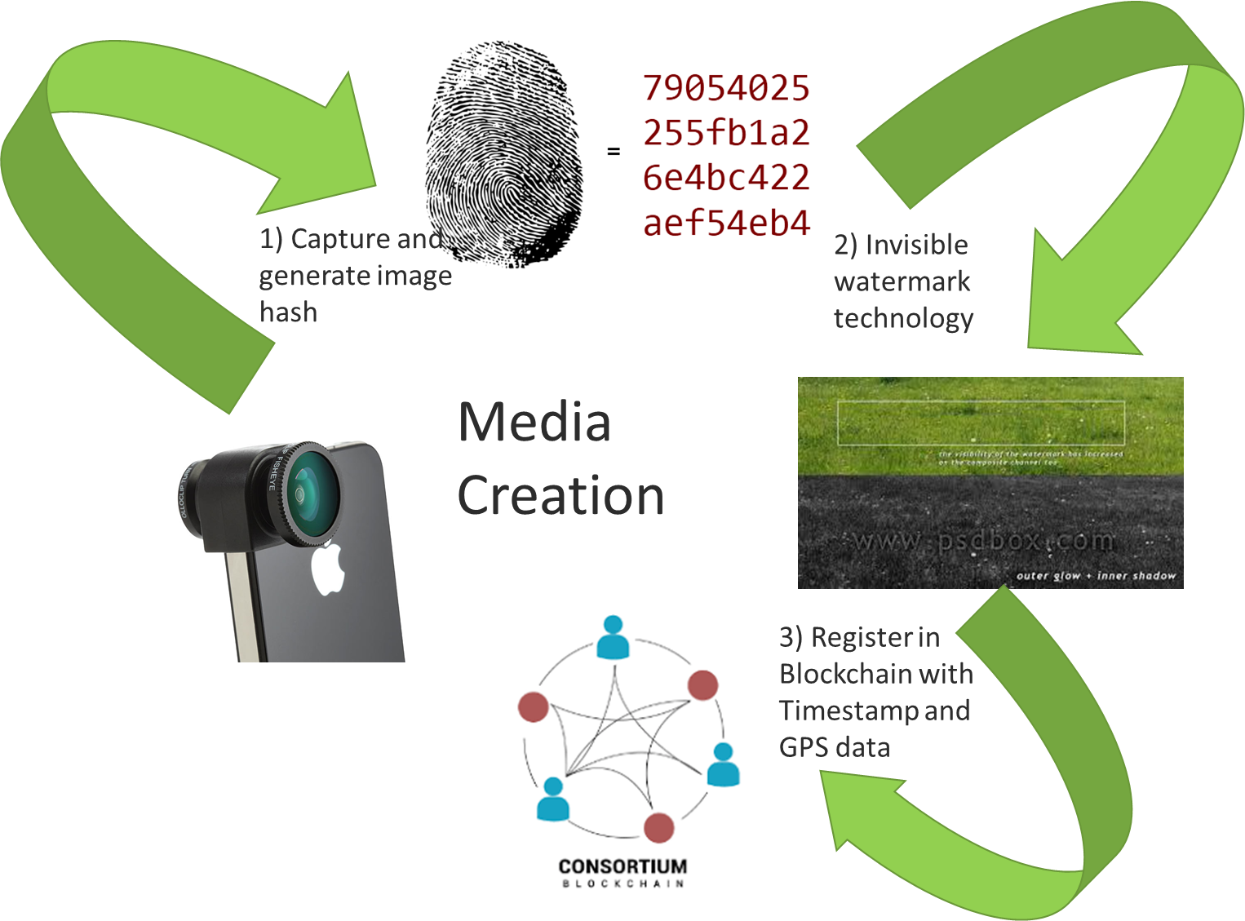
Solution Steps – Check Creation contd.

Slide 5
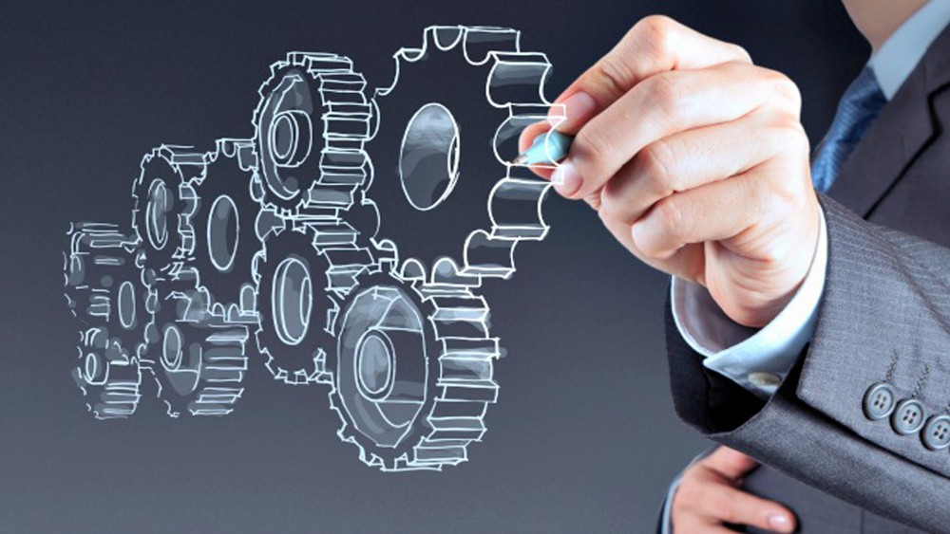

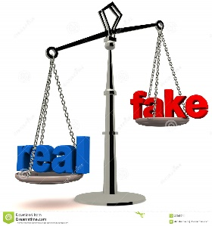
Solution Details- Validation
Cross-Check Validation
Reverse engineering using advanced AIML method to get the hash from media
Calculate fake percentage using NLP and AIML based algorithm.

Slide 6
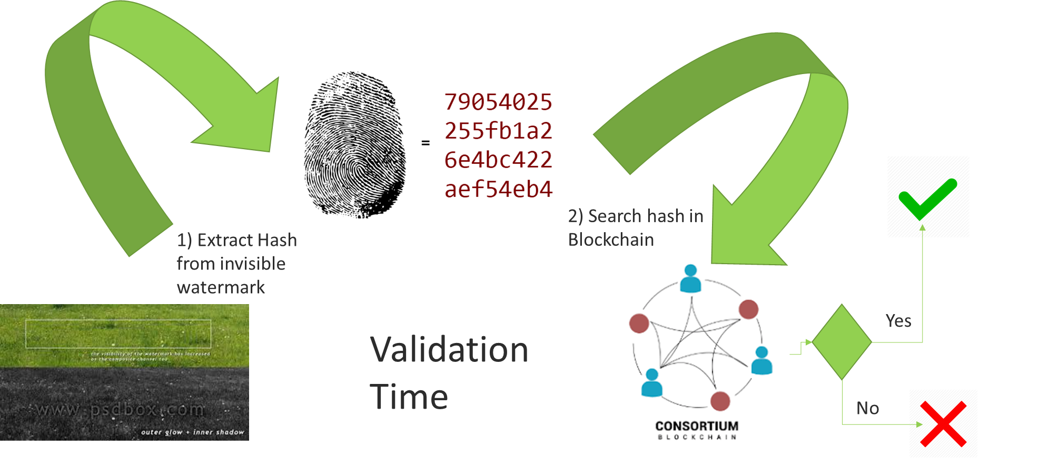
Solution Details- Validation contd.

Slide 7

Solution Benefits & Highlights
01
Introduce Appropriate Business Policy
Trust Regained!
03
It will be impossible to tamper data in BC, that too digested with hash, GPS and Time Stamp
A robust technology readily admissible in the court of law can deter fraudsters forwarding fake
Trust Built!
02
Refrain!
04
Can Save or Earn million
Reinstate sanctity of rightful medium

Slide 8
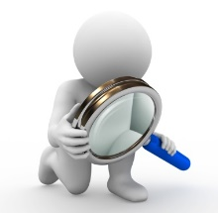
The Ecosystem for the Platform
01
Register media in the tamper proof system
02
On-Demand Validation of news media
03
Put Around a monetization model
The Media will be created by legitimate media house or approved freelancers
All participate in the trust network as provided to be part of the Trust System

Slide 9
An Implementation of the Scheme Explained for Facebook

Slide 10

Facebook can Use this Scheme to Counter Fake News
Blockchain based Content
Steem launched as a blockchain-based social media network that rewarded content creators with financial incentives.
RedPen is a project that will utilize blockchain technology to track journalists’ reputations and communicate that information to readers.
Trive is a social science global consensus engine that researches and clarifies facts and empowers users through cryptocurrency to discover truth through wisdom of the crowd.
Only Biometrically Authenticated Users Can Post Public
Crowdsourced content verification
Track Journalists Reputation

Slide 11
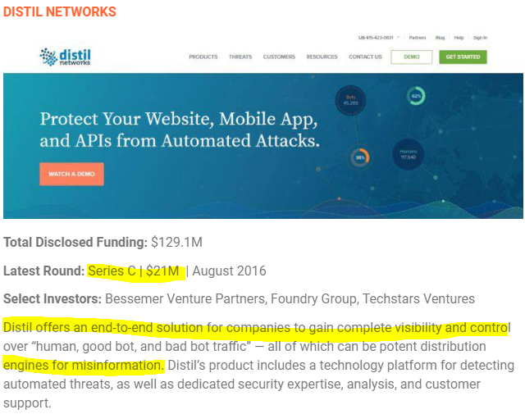

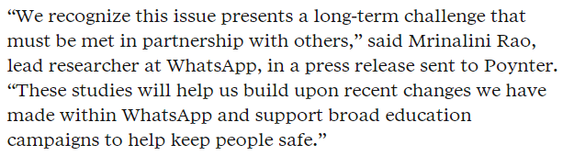


Market Demand

Slide 12
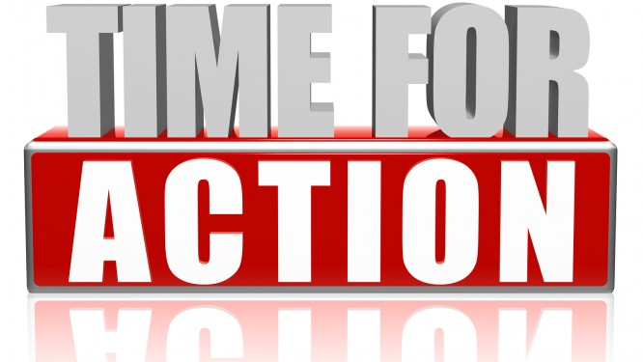
Notes:
You can safely remove this slide. This slide design was provided by SlideModel.com – You can download more templates, shapes and elements for PowerPoint from http://slidemodel.com

Slide 13
 | Image | Content | Tamper With | Fake Chance
News1 | Original Image | This is a hackathon competition. | NA | Not Fake
News2 | Original Image | Some intruders are breaking computers. | Text | HIGH
News3 | Tampered Image | See how they are celebrating pongal. | Image + Text | VERY HIGH
News4 | Original Image | Hackathon competition is very popular now. | Rephrased the text | LOW
Notes:
You can safely remove this slide. This slide design was provided by SlideModel.com – You can download more templates, shapes and elements for PowerPoint from http://slidemodel.com

